Slide 1

Magnetism

Slide 2
History of Magnets
(~800 BC) Ancient Chinese and Greeks discovered that certain stones would attract and magnetize iron.
Small slivers of the stone were found to align themselves with the North Pole.
Chinese were the first to use magnets for navigation.
The orienting properties were used to align streets in cities in the North-South / East-West direction.

Slide 3
Applications
Computer disc drives (hard and floppy)
Credit cards
Speakers
Motors and Generators (Both AC and DC)
And many others…..

Slide 4
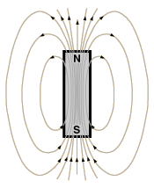
Poles of a Magnet
Magnets have a North and South Pole.
Like poles repel.
Unlike poles attract.
What happens if you break a magnet in half? Will you get two monopoles?
  No.
N S
N S
+
N S
  If you break a magnet in half, you get two magnets.

Slide 5
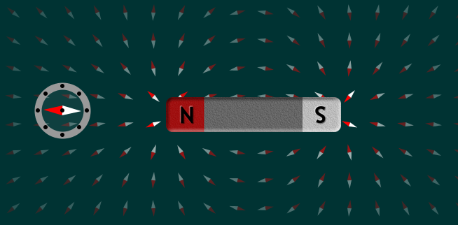
How do Magnets interact with Compasses?
What happens when you put a compass next to a magnet?
N
N
S
Remember, opposites attract.

Slide 6
Magnetic Field Lines
Somewhat similar to electric field lines.
Magnetic field lines point away from the north pole and towards the south pole.
Magnetic field lines are continuous (They do not terminate on the surface!).
Magnetic field lines never cross.
The magnetic field is strongest where the field lines are most concentrated (North and South Pole).

Slide 7
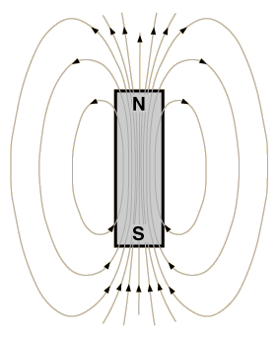
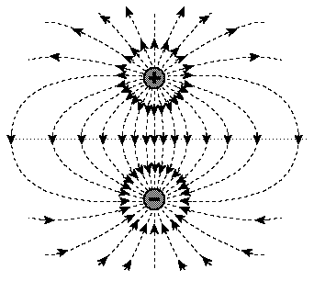
Magnetic Field Lines vs. Electric Field Lines
N
S
Magnetic Dipole
Electric Dipole

Slide 8
The Earth’s Magnetic Field
The earth has a magnetic field that scientist believe is a result of the dynamo effect due to electrical currents created in the molten iron and nickel outer core.
The Earth's Magnetic Field

Slide 9
The Earth’s Magnetic Field
How does a compass behave in Earth’s Magnetic field?
N
Earth’s Magnetic Field

Slide 10

Source of Magnetic Fields
Electrical Charge in motion.
  Currents occur at the atomic level in atoms due to the orbits of electrons around the nucleus.
  The intrinsic spin (+1/2, -1/2) is critical in the case of magnetism.

Slide 11
Magnetic Domains
A: Iron absent of a magnetic field.
B: Iron in the presence of a magnetic field.
C: A non-magnetic material.

Slide 12
Ferromagnetism
Soft Ferromagnets: (Silicon-steels and Iron-Nickel alloys) When the domains align themselves when exposed to an external magnetic field and re-randomize in its absence.
Hard Ferromagnets: (ALNICO, ferrite and neodymium iron boron) Magnetic field persists even in the absence of an external field.
  Domains may realign themselves when exposed to an external magnetic field.
  Shocking them may re-randomize the domains, such as by dropping.
  Heat at or above the Curie point will re-randomize the domains.

Slide 13
Magnetism of Soft Ferromagnetic Materials
How does a magnet attract screws, bolts nails, paperclips, etc. when they are not magnetic to start with?
  Soft ferromagnetic material align their domains in the presence of an external magnetic field creating a magnetic dipole.
    When the magnetic field is removed, the domains re-randomize resulting in no magnetic attraction. They are temporary
    Soft ferromagnetic material is attracted to both the North pole and South pole.
S
N S

Slide 14
Types of Magnetism
Ferromagnetism: Ferromagnetic materials (Iron, Cobalt, Nickel) exhibit a long-range ordering phenomenon at the atomic level which causes the unpaired electron spins to line up parallel with each other in a region called a domain. (B_{ind} ~ B_{app} x 10⁵)
Paramagnetism: Paramagnetic materials (Aluminum, Tungsten, Oxygen) form weak magnetic dipoles at the atomic level when exposed to a magnetic field (B_{ind} ~ B_{app} x 10⁻⁵). Thermal motion results in randomization of the dipoles and a weak net magnetic field.
Diamagnetism: Diamagnetic materials (Gold, Copper, Water) respond to magnetic fields by developing a weakly opposing magnetic field (B_{ind} ~ -B_{app} x 10⁻⁵).
B_{ind} = Induced Magnetic Field, B_{app} = Applied Magnetic Field

Slide 15
Example 1: Application of Magnetism
What type of ferromagnetic material would you use for video cassette tapes, audio cassette tapes, credit card strips, hard drives or floppy discs?
Soft Ferromagnetic
Hard Ferromagnetic
Diamagnetic
Paramagnetic
Diamagnetism and paramagnetism are too weak, and soft ferromagnetic material is temporary while the external field exists.

Slide 16
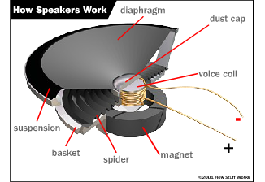
Types of Magnets
Temporary: When charged particles move through space, they induce a magnetic field (Electromagnets).
Permanent: Electrons have an intrinsic magnetic field that may add together in certain matter to create a magnetic field (Speakers).
Temporary
Permanent

Slide 17
Key Ideas
All magnets have North and South Poles
Magnetic field lines originate in the North and end at the south pole.
Magnetic field lines do not cross.
Magnetism exists at the atomic level.
Magnetism is the result of moving charges.
Some magnets are temporary while others are permanent.
Types of Magnetism.
  Ferromagnetism.
  Paramagnetism.
  Diamagnetism.

